Slide 1
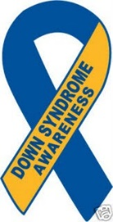
Down Syndrome BY: Bryant Miller
Down Syndrome is a genetic disorder, causing lifelong intellectual disability and slower development.

Slide 2
Causes
Down Syndrome is neither autosomal dominant or recessive gene. This illness is not sex-linked. Down Syndrome is Non disjunction as result it having 3 copied chromosome 21 instead of 2. Most cases you do not inherit Down Syndrome.

Slide 3
Facts
Down Syndrome occurs in every 800-1,000 new born babies. 400,000 people in the U.S. have Down Syndrome. Women under 35 have a higher chance of having a child with Down Syndrome. As women age the risk of them conceiving a child with the Disease decreases.

Slide 4
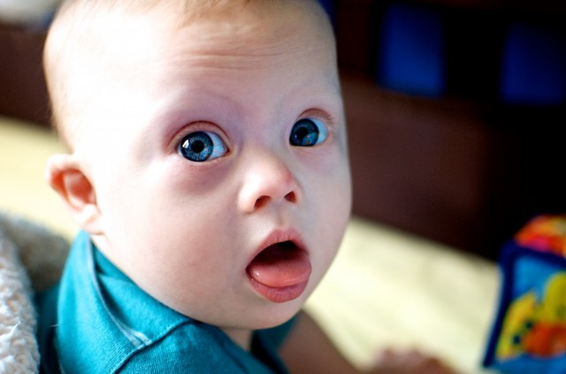
Symptoms
Flattened facial features
Small head
Short neck
Protruding tongue
Upward slanting eyes, unusual for the child's ethnic group
Unusually shaped or small ears
Poor muscle tone
Broad, short hands with a single crease in the palm
Relatively short fingers and small hands and feet
Excessive flexibility
Tiny white spots on the colored part (iris) of the eye called Brushfield spots
Short height

Slide 5
Testing & Screening
Screen testing can give you a estimate of the chance your baby might have Down Syndrome, cant give you the answer on a estimate. The Diagnose test will tell you if your baby has Down Syndrome.

Slide 6
Treatment
There is no single, standard treatment for Down syndrome. Treatments are based on each individual's physical and intellectual needs as well as his or her personal strengths and limitations. People with Down syndrome can receive proper care while living at home and in the community.

Slide 7
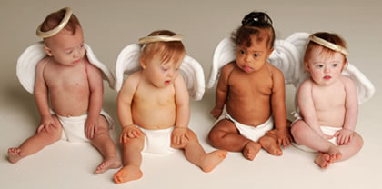
Future plan
For Kids with Down Syndrome they will receive the help and treatment they need for there struggling parts. They all have bright future. There illness can not stop them from achieving there goals.

Slide 8
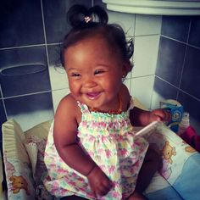
Facts
In 1983, the average life expectancy of a person with Down syndrome was a mere 25-years-old. Today, it’s 60.
While behavior, mental ability, and physical development varies from person to person, many individuals with Down syndrome grow up to hold jobs, live independently, and enjoy normal recreational activities.

Slide 9
Cited
http://www.mayoclinic.org/diseases-conditions/down-syndrome/basics/definition/con-20020948
https://www.healthtap.com/user_questions/1232989
https://www.google.com/#q=is%20down%20syndrome%20nondisjunction
http://www.dsat.org/faq.asp
http://www.ndss.org/Global/NDSS%20Promising%20Future%20Together.pdf

